Slide 1

Integration of Databases for Mortality Analysis in the USA
{
<STUDENTS
="BENJAMÍN FERNANDEZ"
"MAXIMILIANO SEPULVEDA"
/>
<PROFESSOR
= "MG. FELIPE VASQUEZ/>
}

Slide 2
Introduccion {
Why Did We Analyze This Data?
We chose U.S. mortality data due to its high quality, standardization, and level of detail, which enables in-depth analysis of causes of death by state and year.
Project Objective
To integrate mortality data from ClickHouse and Neo4j in order to identify trends, anomalies, and patterns using an ETL process that consolidates both datasets for efficient analysis.
}

Slide 3
Public Dataset: Leading Causes of Death in the USA {
Death rates
Leading cause death
Contains annual death rates per 100,000 inhabitants.
Columns: Year, Cause of Death, Death Rate, Age Group, Sex, State.
Covers all U.S. states from 1900 to 2013
Allows time series analysis of mortality trends.
Lists the top 10 causes of death per year and state.
Columns: Year, State, Cause of Death, Deaths, Population.
Data from 1999 to 2020 across all U.S. states.
Enables exploration of geographic and temporal patterns.
}

Slide 4
Selected databases

Slide 5




Justification for the Choice of Databases ( {
Optimized for time-series data (death rates over years).
Death rates
Handles large volumes of historical data efficiently (1900–2013).
Columnar storage reduces I/O (input/output) for selected fields.
Scales horizontally to handle growing data needs.
}

Slide 6

Justification for the Choice of Databases ( {
Graph model naturally represents relationships between states, years, and causes.
Leading cause
death
Efficient for exploring complex connections and patterns in data.
Ideal for geographic and temporal relationship analysis.
Scales horizontally to handle growing data needs.
}

Slide 7
Data integration

Slide 8

Data Integration Process {
.
LOAD CSV INTO CLICKHOUSE
LOAD CSV INTO NEO4J
MERGE DATA FROM
BOTH DATABASES
}

Slide 9




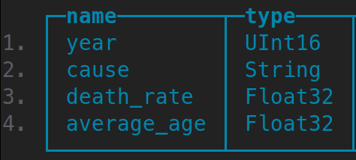
LoAD CSV INTO CLICKHOUSE
Prepared and loaded mortality data into ClickHouse
Extracted from a public CSV with age-adjusted death rates (USA)
Cleaned column names for compatibility
Created death_rates table
(year, cause, death_rate)
Removed previous versions of the table to avoid conflicts

Slide 10
Data Integration Process {
.
LoAD CSV INTO CLICKHOUSE
LOAD CSV INTO NEO4J
MERGE DATA FROM
BOTH DATABASES
}

Slide 11
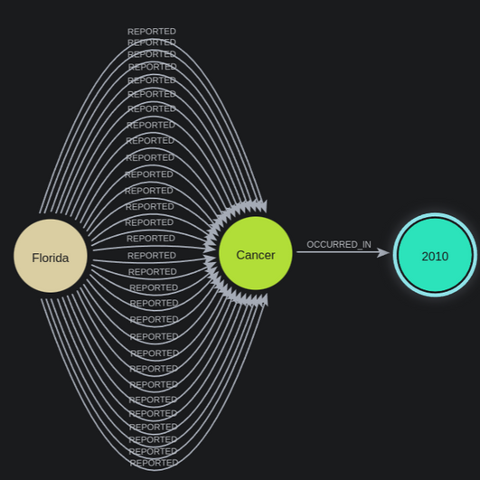
LoAD CSV INTO NEO4J
Processed CSV with deaths by cause, state, and year (USA)
Filtered relevant columns and cleaned null/invalid values
Modeled data in Neo4j as a graph (States, Causes, Years)
Created relationships showing deaths per cause, state, and year

Slide 12

Data Integration Process {
.
MERGE DATA FROM
BOTH DATABASES
LoAD CSV INTO CLICKHOUSE
LOAD CSV INTO NEO4J
}

Slide 13
Merge DATA FROM
BOTH DATABASES
It integrates both databases by mapping common elements.
It features an interactive menu with the following options:
Analysis by cause and year
Export CSV with combined data
For the analysis, we used two approaches: one using the CSV export, and another through the interactive menu.
The integration.py script represents the final stage of the ETL process, focused on the integration and joint analysis of data from the ClickHouse and Neo4j databases.
This script establishes simultaneous connections to both sources and uses a cause name mapping (CAUSE_MAP) to ensure compatibility between the records.
}

Slide 14
Analysis

Slide 15
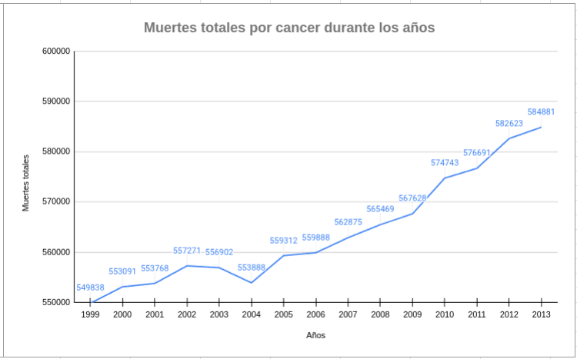
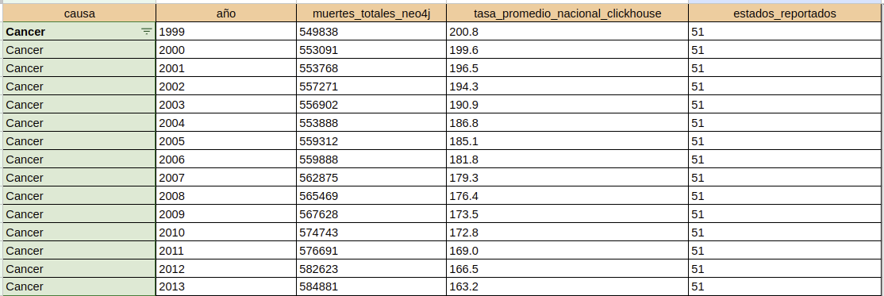
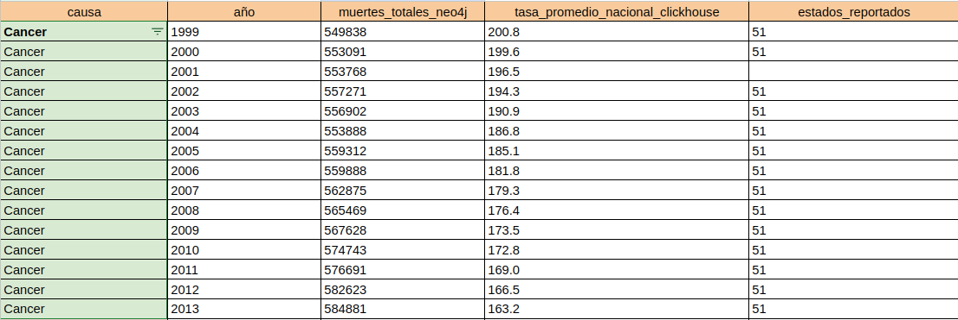
Analysis 1 {
Analysis: Cancer (1999–2013) using Integrated CSV Data
Total Deaths:
From 1999 to 2013, the total number of cancer deaths in the U.S. increased from 549,838 to 584,881. This moderate rise is likely linked to population growth.
National Mortality Rate:
Despite the increase in total deaths, the average national mortality rate decreased from 200.8 to 163.2 deaths per 100,000 people. This suggests progress in prevention, early diagnosis, and treatment.
}

Slide 16
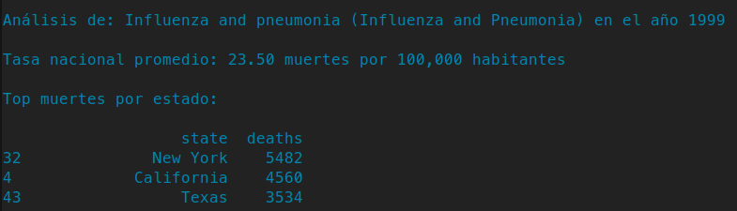
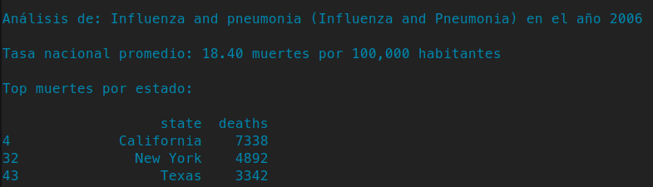
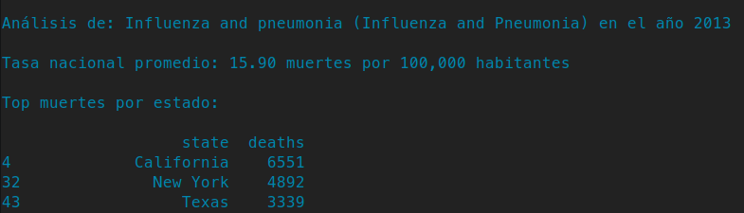
Analysis 2 {
Analysis: Influenza and Pneumonia (1999–2013) using Interactive Menu
National Trend:
The national mortality rate decreased from 23.5 to 15.9 deaths per 100,000 people, indicating progress in prevention, treatment, and vaccination efforts.
States with Highest Deaths:
California, New York, and Texas consistently had the highest absolute numbers, mainly due to their large populations.
Example: California reduced deaths from 8,324 (2000) to 6,551 (2013).
}

Slide 17
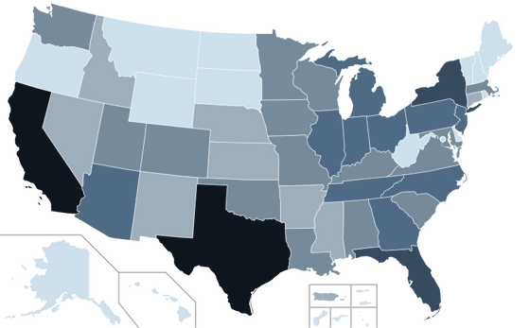




Conclusions {
INTEGRATION
INSIGHTS
IMPACT
Clickhouse
Successfully combined ClickHouse
&
Neo4j to analyze mortality data
Identified trends and patterns across
time and geography
Demonstrated the value of using
specialized NoSQL databases
}

Slide 18
<!-- -->
Thanks for watching {
<By="Benjamín Fernández",
“Maximiliano Sepulveda”/>
}

Slide 19
Integration of Databases for Mortality Analysis in the USA
{
<STUDENTS
="BENJAMÍN FERNANDEZ"
"MAXIMILIANO SEPULVEDA"
/>
<PROFESSOR
= "MG. FELIPE VASQUEZ/>
}

